Slide 1

Process Mining Virtual Internship
by
M chaitanya kumar
Roll No. 214G1A3210
Department of Computer Science and Engineering (Data Science)
Srinivasa Ramanujan Institute of Technology
(Affiliated to JNTUA & Approved by AICTE) (Accredited by NAAC with ‘A’ Grade & Accredited by NBA (EEE, ECE & CSE)
Rotarypuram Village, B K Samudram Mandal, Ananthapuramu – 515701.
2023 - 2024

Slide 2

Contents
Course Objective
Introduction
Tools of Process Mining
Applications
Modules
Real Time applications
Learning outcomes
GitHub Link
Queries

Slide 3
Course Objective
Develop a solid understanding of process mining fundamentals, including event logs, process discovery, conformance checking, and enhancement techniques, enabling participants to analyze and optimize real-world processes.
Equip participants with hands-on experience using popular process mining tools and interpreting insights from process visualizations, empowering them to apply process mining techniques effectively in diverse industries and problem-solving scenarios.

Slide 4
Introduction
We have done this internship under Eduskills in association with AICTE.
Eduskills is a Non-profit organization which enables Industry 4.0 ready digital workforce in India.
They are associated with 50 plus colleges and thousands of students registered in this platform. They are associated with govt.bodies like ESTD,ISTE,IETE.
The process mining was done in the platform of Celonis website, it helps companies achieve process excellence through its platform by eliminating operational friction with their Intelligent Business Cloud platform
Celonis is an American-German data processing company that offers software as a service (SaaS) to improve

Slide 5
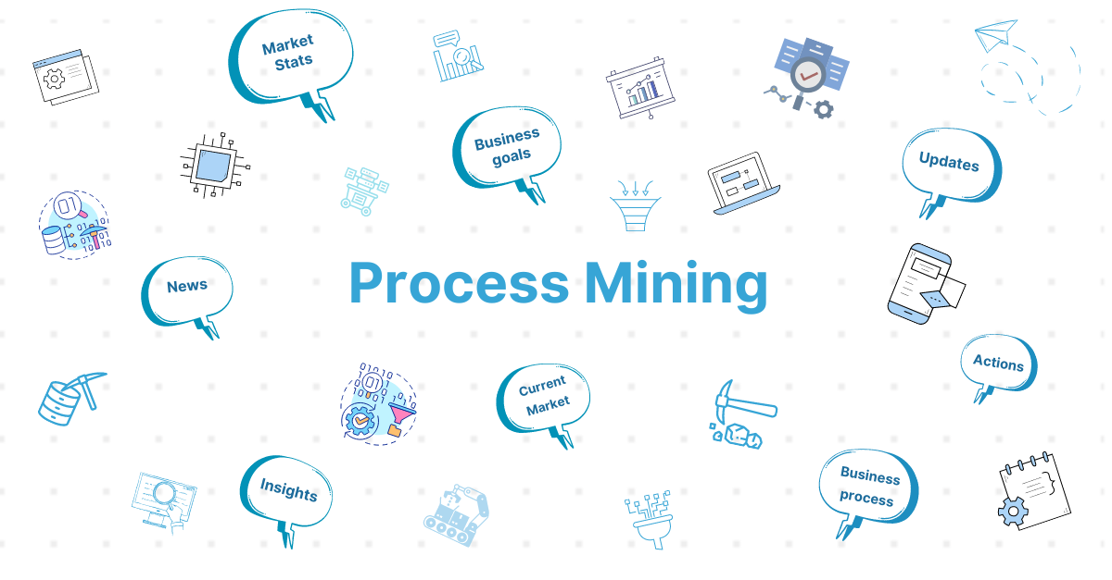
Intro...
What is Process Mining?
Process mining is a method that uses data from ditgital systems and create visual representations of how processes actually happen. It involves extracting data from event logs and identifies bottle necks and suggests a ways to make them more efficient.
.

Slide 6
Steps involved in process mining
Data Extraction
Data Preparation
Process Discovery
Conformance Analysis
Root Cause Analysis
Enhancement and Actionable Insights

Slide 7
Process Mining Tools
Celonis
Disco
prom
Minit

Slide 8
Applications
Process discovery: identifying the actual process flow based on event logs.
Conformance checking: comparing the actual process flow to the intended process flow, and identifying deviations.
Process enhancement: optimizing and improving the process based on the insights gained from process mining.
Process discovery
Conformance checking.
Process enhancement

Slide 9
Uses of process mining
Improved process efficiency and effectiveness.
Better visibility into process performance and bottlenecks.
Identification of opportunities for automation and digital transformation.
examples:
Customer Journey Analysis: Identify pain points and areas for improvement in customer journeys.
Risk Management: Identify and mitigate risks by analyzing deviations and potential issues in processes.
Human Resources:Analyze HR processes such as recruitment, onboarding, and performance management.
Healthcare Process Analysis: Analyze patient treatment pathways, hospital operations.

Slide 10

Modules in Process Mining
Rising Star Technical
Process Mining
Process Mining
Fundamentals
EMS

Slide 11
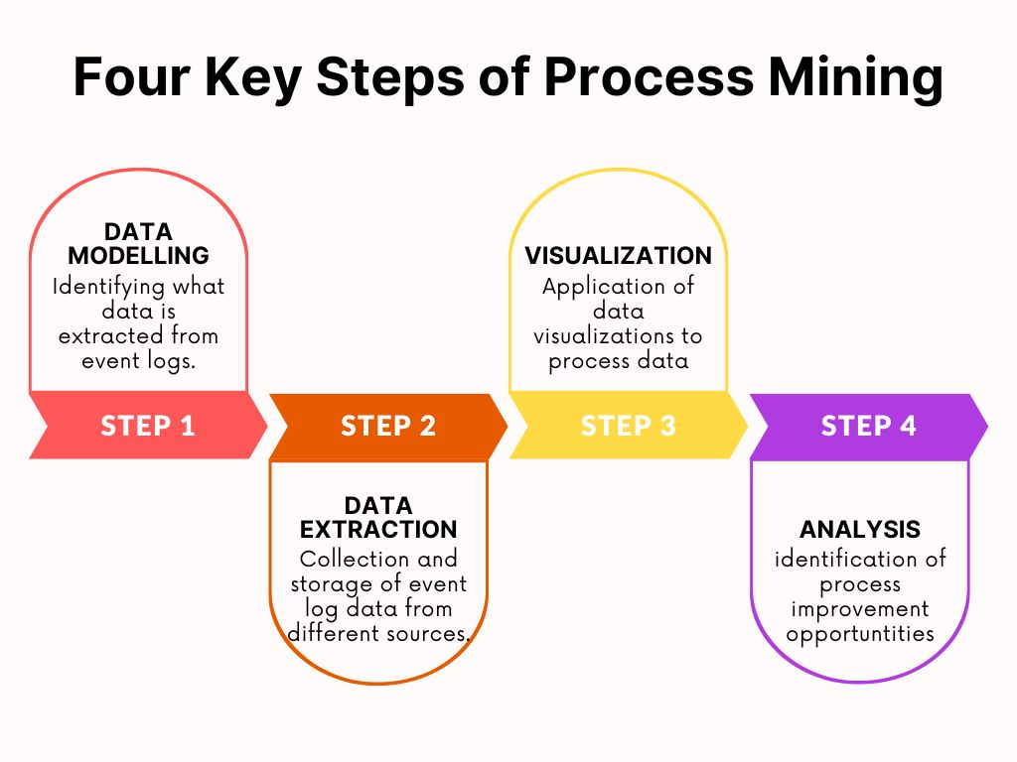
Celonis Process Mining Fundamentals
Main Stages in Process Mining:
Data Modeling.
Data Extraction.
Data Visualization.
Data Analysis.

Slide 12
Execution Management Consulting For Students
Execution Management is a strategic approach to managing and improving business processes using real-time insights, data analysis, and continuous monitoring and components involved in excution mangement are
Process Understanding: Grasp how tasks are done in real-world processes.
Spotting Inefficiencies: Identify where processes can be faster or smoother.
Data Analysis: Learn to work with and analyze large sets of data.
Visualizing Data: Create clear process maps and visuals.
Smart Decisions: Use data to make informed choices for improvement.
Automation Insights: Discover tasks ripe for automation.
Risk Detection: Spot deviations that might lead to errors or delays.
Constant Improvement: Develop a habit of making processes better over time.
Team Collaboration: Bring different teams together for process enhancement.
Business Impact: Boost efficiency, cut costs, and make customers happier.

Slide 13
Real world Applications
Real-time process mining can be applied in various industries and scenarios. Here are some specific examples:
Customer Service: By analyzing real-time event data from customer interactions, process mining can help identify patterns and bottlenecks in customer service processes, enabling organizations to improve response times, enhance customer satisfaction, and streamline support workflows.
Fraud Detection: Real-time process mining can be used to detect fraudulent activities by continuously analyzing event data and identifying suspicious patterns or deviations from normal behavior, allowing organizations to take immediate action to prevent or mitigate potential fraud.
Healthcare: Real-time process mining can be applied in healthcare settings to monitor patient flows, optimize resource allocation, and improve the efficiency of healthcare processes, such as patient admissions, discharge, and treatment pathways.
Manufacturing: Real-time process mining can be utilized in manufacturing processes to monitor production lines, identify bottlenecks, track quality issues, and optimize resource allocation, helping organizations improve productivity and reduce downtime.

Slide 14
Learning outcomes
By this I learnt about the Process mining.
Mining and process of data.
Usage of process mining tool and real life applications.
Concept of Execution Management and its Benefits.
How the process mining would be done is also explained by it.

Slide 15
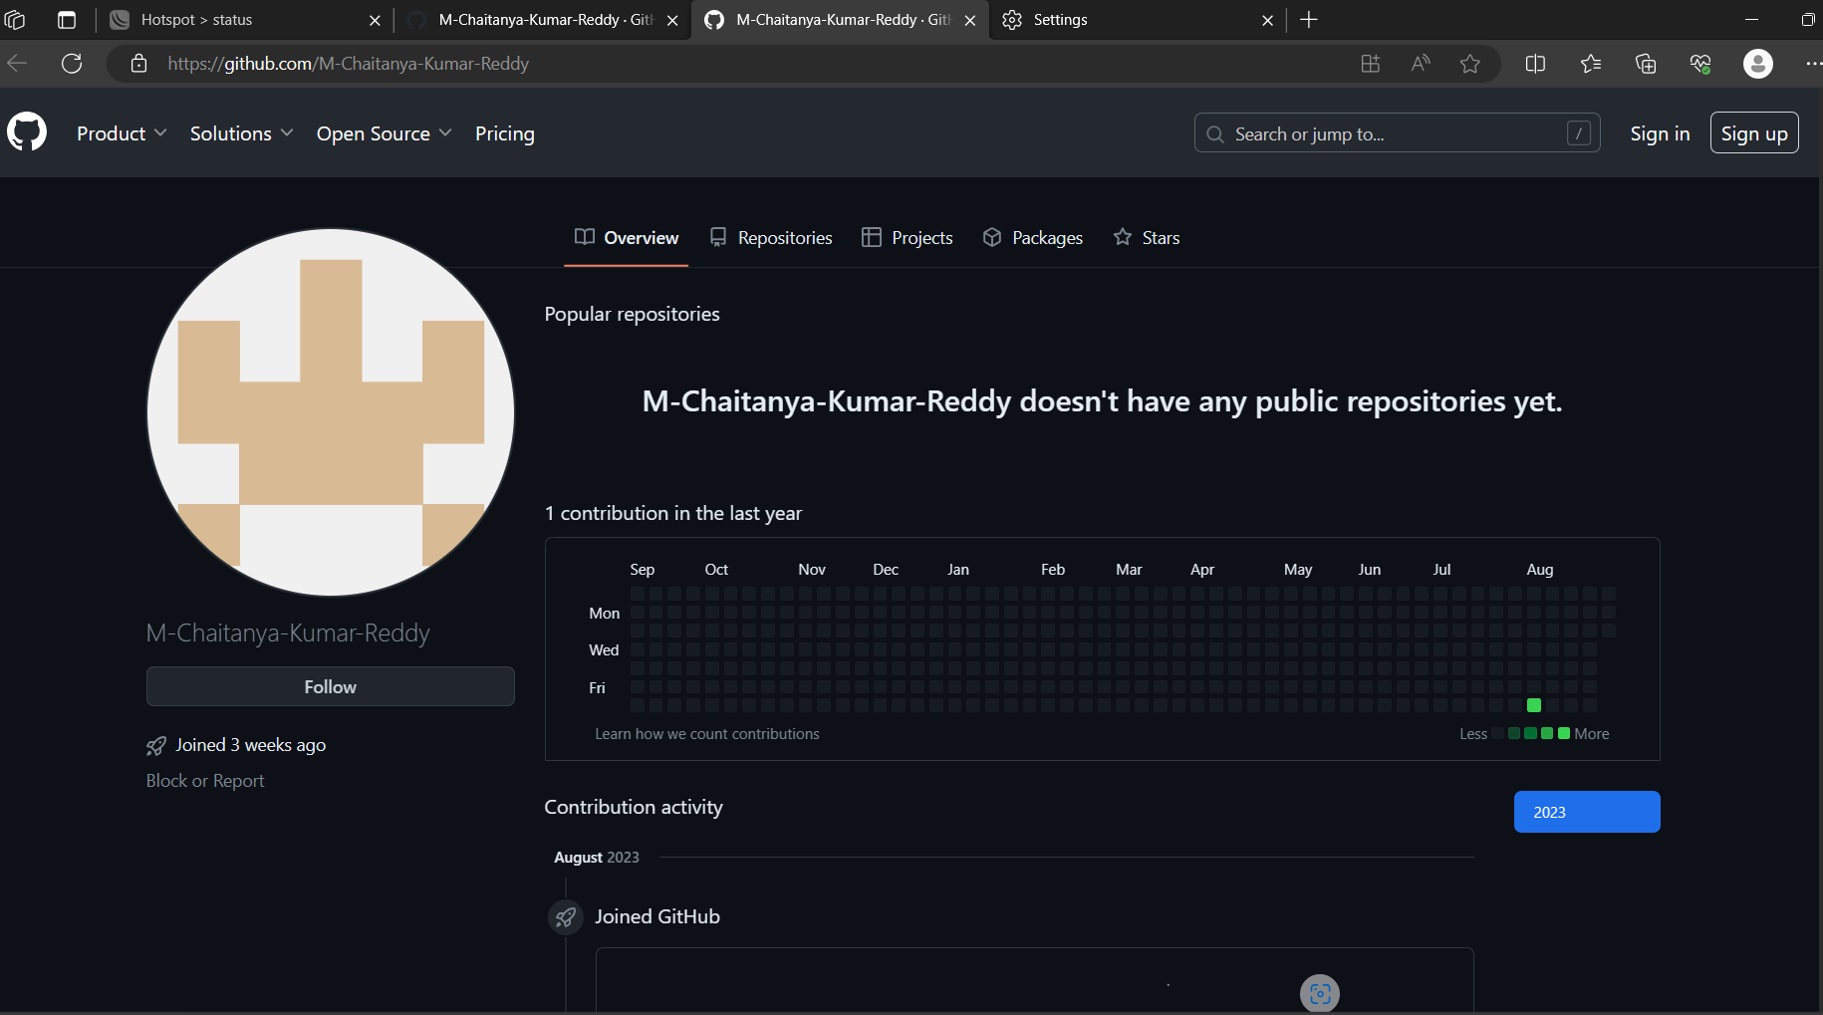

Git Hub Dashboard
Repository Name Like: Summer Internship - I
Under that include document, presentation and Certificate(Pdf).

Slide 16
Any Queries?

Slide 17
Thank You!!!

